Slide 1
AI STUDY AND PLACEMENT PLANNER

Slide 2
INTRODUCTION
AI Study & Placement Planner is a full-stack AI-powered web application designed to help students manage academics and placement preparation on a single platform. The project was developed to solve the problem of using multiple separate applications for study planning, coding practice, productivity tracking, and interview management. It provides intelligent recommendations and performance analytics to help students improve productivity and learning efficiency.

Slide 3
PROBLEM STATEMENT
Students use multiple applications for study planning, coding practice, placement preparation, and productivity tracking.
Managing different platforms becomes time-consuming and unorganized.
Existing systems lack centralized management and intelligent guidance.
Students face difficulty tracking progress and identifying weak areas.
There is a need for a single AI-powered platform that provides smart recommendations, productivity tracking, and efficient study management.

Slide 4
AIM
To develop a centralized platform for study and placement management.
To help students organize academic and placement preparation activities efficiently.
To track coding progress, skills, and productivity.
To provide AI-based personalized recommendations for improvement.
To improve student consistency, time management, and learning efficiency.

Slide 5
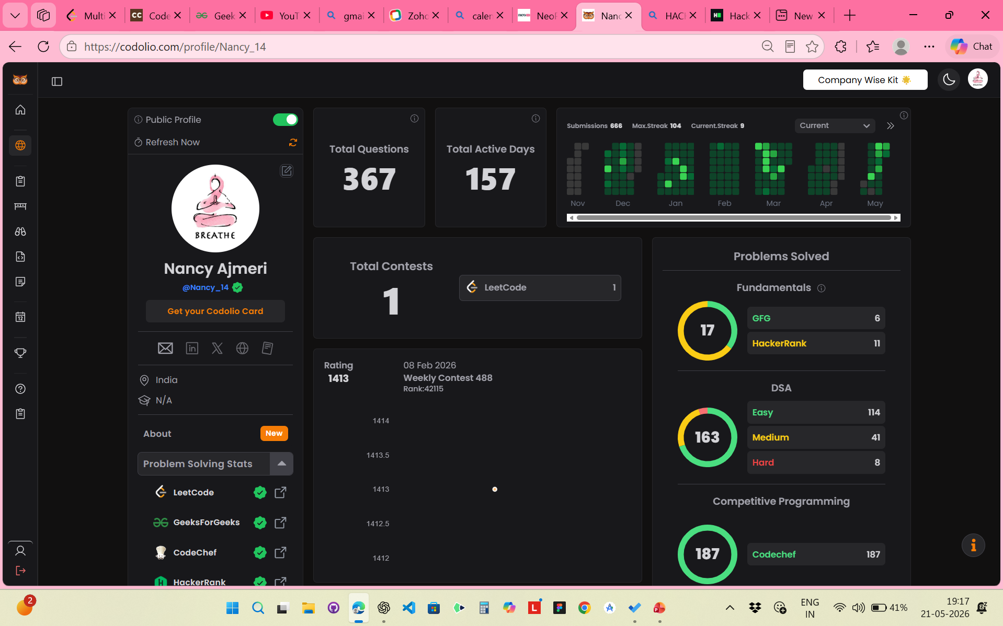
EXISTING SYSYEM

Slide 6
PROPOSED SYSTEM
A centralized AI-powered platform for students.
Combines study planning, coding practice, and placement preparation in one system.
Tracks productivity, skills, and academic progress efficiently.
Uses Machine Learning to analyze student performance.
Provides personalized recommendations and performance analytics.
Reduces dependency on multiple applications and improves organization.

Slide 7
TECHNOLOGIES USED
HTML – Structure of the web pages
CSS – Styling and user interface design
JavaScript – Interactive frontend functionality
Python – Core programming language
Flask – Backend web framework
MongoDB – Database management
scikit-learn – Machine Learning and recommendation logic
pandas – Data handling and preprocessing
NumPy – Numerical and mathematical operations
Matplotlib – Data visualization and analytics charts

Slide 8
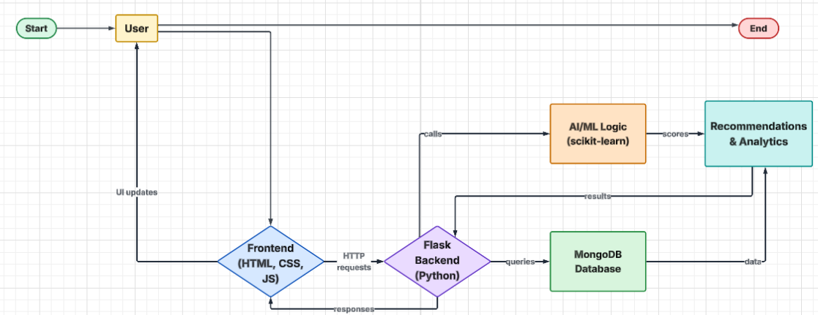
SYSTEM ARCHITECTURE

Slide 9
MODELS AND FEATURES
1. Study Planner
Helps students manage daily study schedules and tasks.
2. Coding Tracker
Tracks coding practice, solved problems, and consistency.
3. Skill Tracker
Monitors progress in technical skills and subjects.
4. Placement Preparation Module
Manages aptitude preparation, interview schedules, and placement activities.
5. AI Recommendation Engine
Analyzes student performance and provides personalized study recommendations.
6. Analytics Dashboard
Displays productivity graphs, progress charts, and performance analytics.
7. Productivity Tracker
Tracks study hours, completed tasks, and overall consistency.

Slide 10
AI/ML WORKING
Data Analyzed by AI
Study hours
Completed tasks
Coding consistency
Skill progress
Subject-wise performance
Productivity records
Working of the Recommendation System
The system collects and stores student activity data.
AI analyzes weak subjects and low productivity areas.
Machine Learning logic identifies performance patterns.
Personalized recommendations are generated based on analysis.
Example Recommendation
If DSA progress is low:
“Practice DSA for 1 hour today.”
ML Libraries Used
scikit-learn – Recommendation and prediction logic
pandas – Data preprocessing and analysis
NumPy – Mathematical operations
Matplotlib – Analytics and visualization graphs

Slide 11
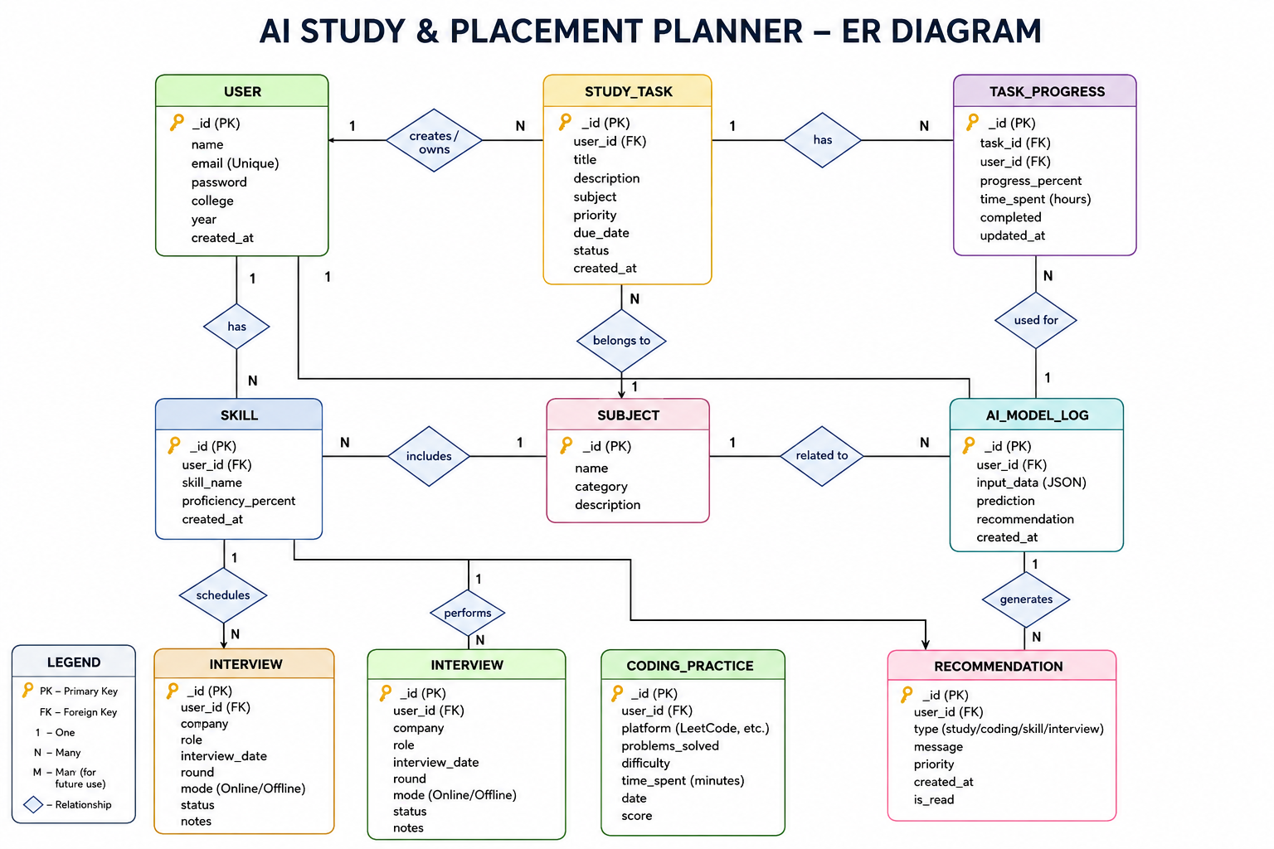

Slide 12
Workflow / Project Flow
Step 1
User enters study tasks, coding progress, and productivity data.
Step 2
Frontend sends the data to the Flask backend.
Step 3
Backend processes and stores the information in MongoDB.
Step 4
AI/ML module analyzes study patterns, weak areas, and productivity.
Step 5
Machine Learning logic generates personalized recommendations.
Step 6
Recommendations, analytics, and progress reports are displayed on the dashboard.

Slide 13
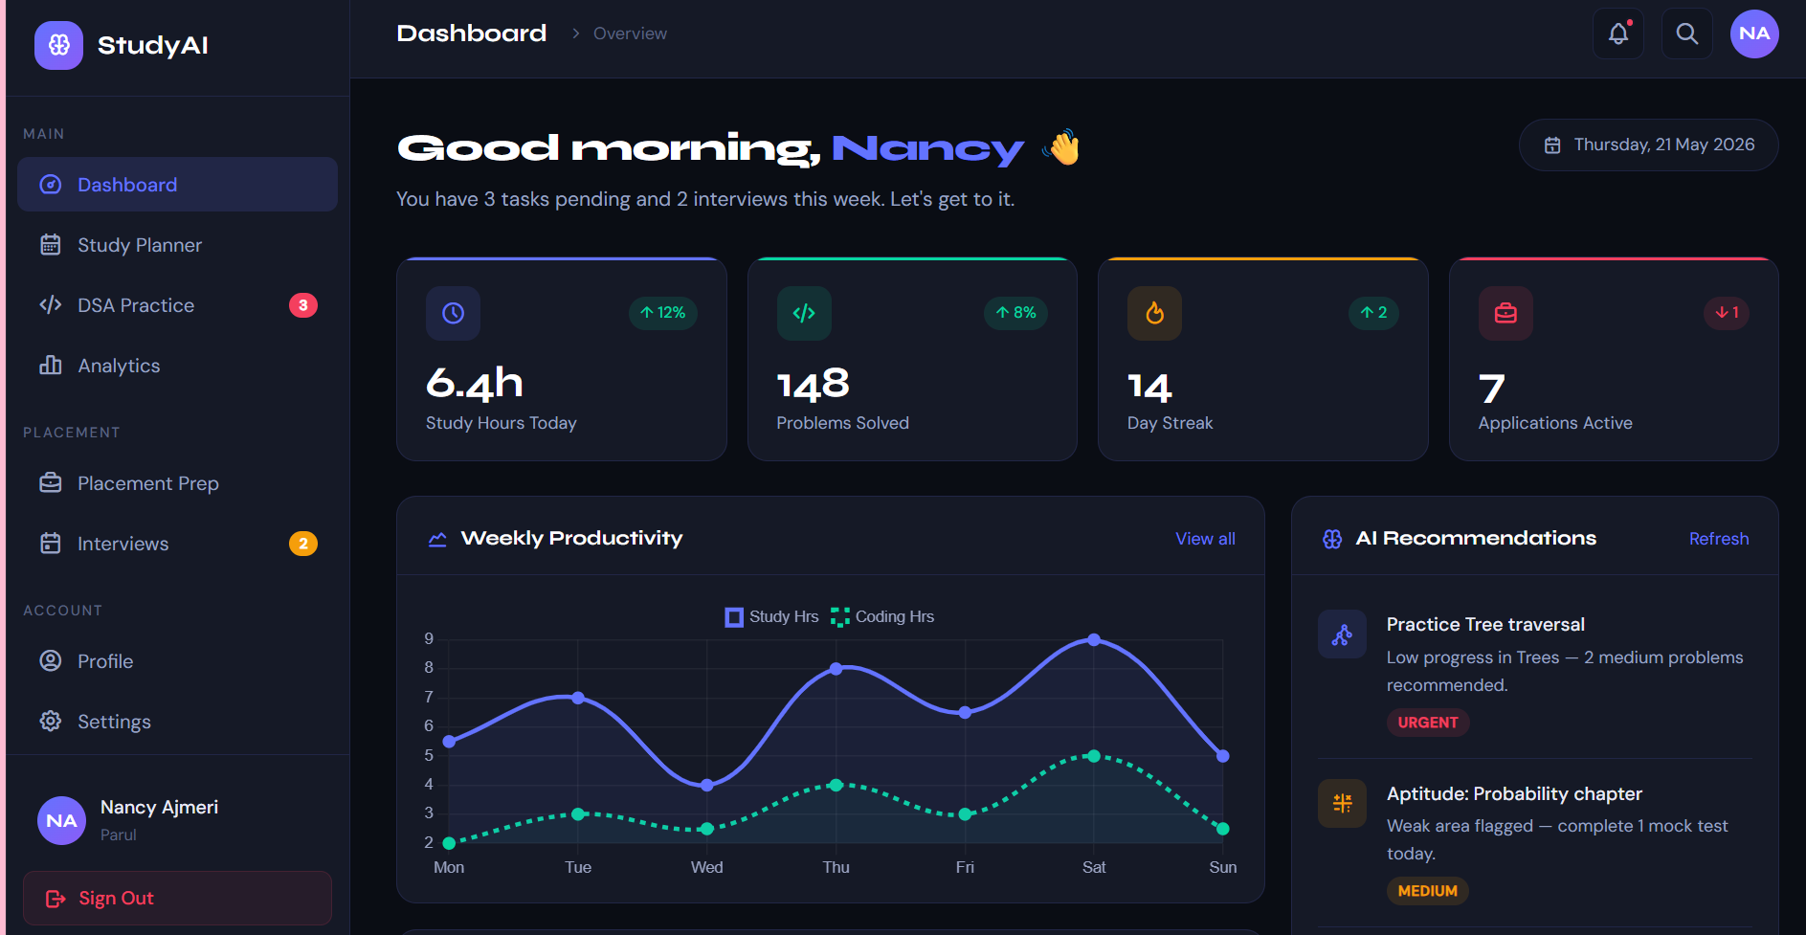
UI

Slide 14
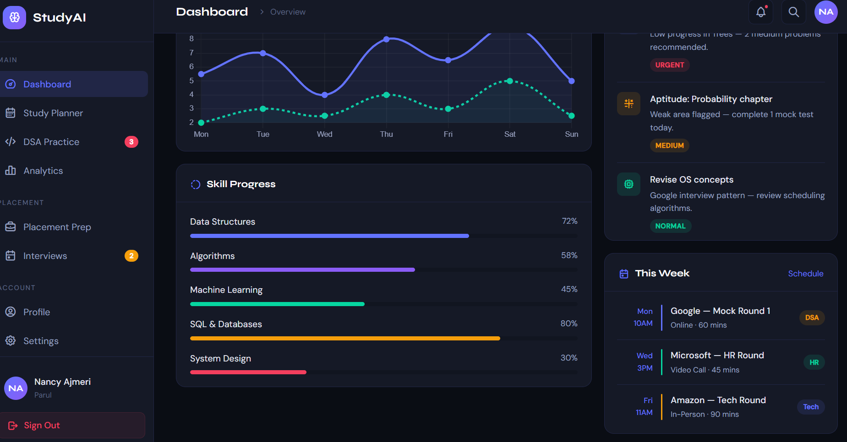

Slide 15
ADVANTAGES
Centralized platform for study and placement management. Improves student productivity and time management. Provides AI-based personalized recommendations. Easy tracking of coding progress and skill development. Helps identify weak subjects and performance gaps. Reduces dependency on multiple applications. Interactive dashboard with analytics and visualization. User-friendly and efficient system for students.

Slide 16
FUTURE SCOPE
Integration of AI chatbot for student assistance.
Resume analyzer for placement preparation.
Notification and reminder system for tasks and interviews.
Voice assistant support for smart interaction.
LeetCode and coding platform API integration.
Advanced Machine Learning models for performance prediction.
User authentication and personalized profiles.
Mobile application support for better accessibility.
Real-time analytics and progress monitoring.

